Slide 1

Most Popular Mobile Network
Business Statistics (STAT-4800-W02)
Instructor: Dr Kevin Craib
Due Date: 14th December 2021

Slide 2

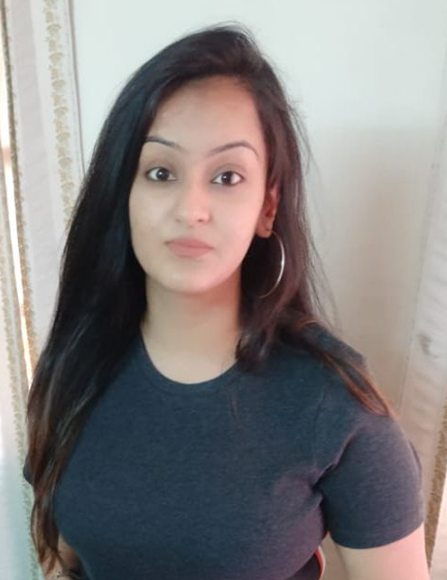

Group 7
Meet our Team
Sinisa Nezic 100370560
Mehak Chatrath
100370805
Saurav
100358145

Slide 3


Introduction & Objectives
Data is collected from a sample of 100 students who were studying in Langara college during spring 2018 semester
The main objective of the study is to find our the most popular mobile network among the students
Sample here in the study is 100 langara students
Elements are langara students
Population is all Langara students studying during spring 2018 semester

Slide 4

Methods
Data used in the study is collected from Primary source of data (directly asked by the students through survey or interview)
Variables used in the study are as both qualitative and quantitative. V2, V5, V7, V12 are qualitative and rest are quantitative (V1, V3, V4, V6, V8, V9, V10, V11)
For Bivariate data; we used scatter diagram, four steps of hypothesis testing, chi square test, correlation coefficient and estimation of regression equation
For Univariate qualitative data; we used pie chart, bar chart and relative frequency distribution table and for Univariate quantitative data; we used histogram, box and whisker diagram and Tukey’s 5 number summary
☹

Slide 5


Results
Univariate Analysis

Slide 6
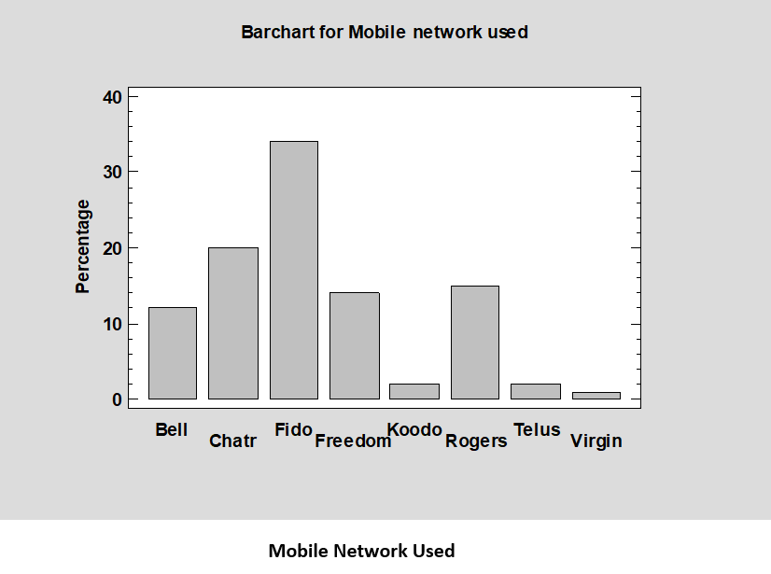
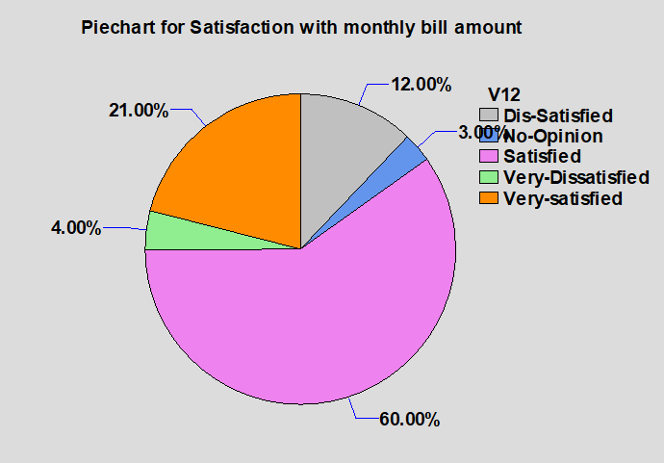
Data variable:
V5 (Mobile Network used)
Number of observations: 100
Number of unique values: 8
Data variable:
V12 (Satisfaction with monthly bill amount)
Number of observations: 100
Number of unique values: 5
Frequency Table for V12 (Satisfaction with monthly bill amount)
 |  |  | Relative | Cumulative | Cum. Rel.
Class | Value | Frequency | Frequency | Frequency | Frequency
1 | Dis-Satisfied | 12 | 0.12 | 12 | 0.12
2 | No-Opinion | 3 | 0.03 | 15 | 0.15
3 | Satisfied | 60 | 0.6 | 75 | 0.75
4 | Very Dissatisfied | 4 | 0.04 | 79 | 0.79
5 | Very satisfied | 21 | 0.21 | 100 | 1
V5 -
- V12
Interpretation:
From Bar chart we can see that most frequently mobile network used was Fido with 34%. Fido is followed by Chatr with 20%, and on third place was Rogers with 15%. Very close to Rogers was Freedom with 14%. The least popular mobile network were Telus and Kodo with 2%, and Virgin with just 1%
Interpretation:
The majority of the Langara students in the sample were satisfied with their monthly bill amount, 60% of them. 21% said that they were very satisfied, while 12% were dissatisfied. 4% of them were very dissatisfied, and 3% had no opinion.

Slide 7
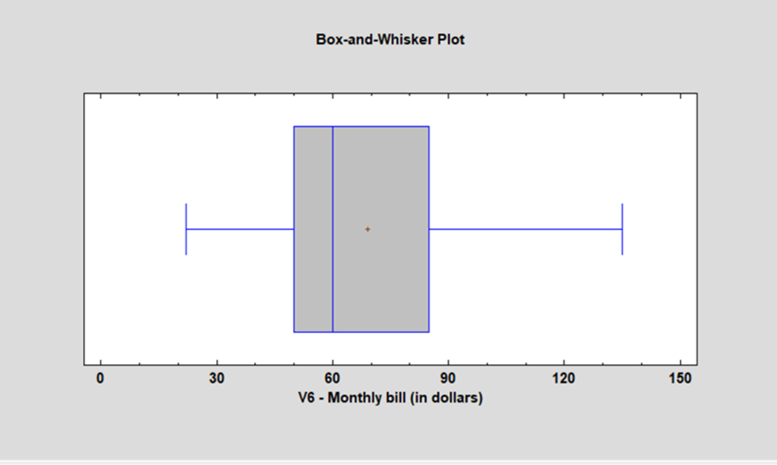
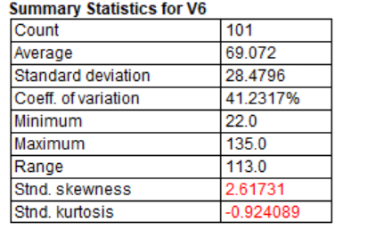
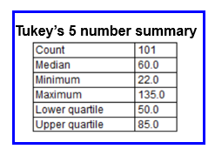
Data variable: V6 (monthly Bill – in dollars)
101 values ranging from 22.0 to 135.0
Interpretation:
The shape of the diagram is skewed to right. The median is 60 and the sample mean is 69.072. There is no outlier present for the description. The range is between 22 and 135.
So we can say that most of the Langara students get a bill around $60 - $70.

Slide 8
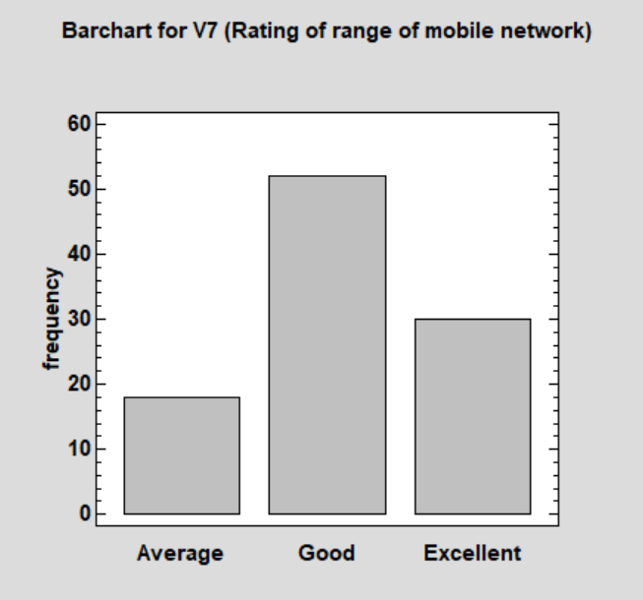
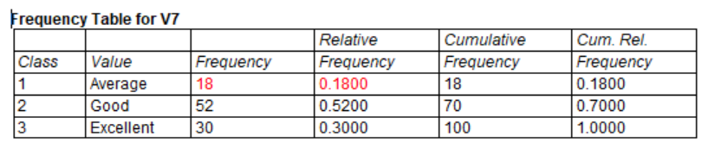
Data variable: V7 (Rating of range of mobile network)
Number of observations: 100
Number of unique values: 3
Percentage
Interpretation:
The majority of the Langara agree that the rating of range of mobile network are good, 52% of them. 30% students also thought that the rating of range of mobile network is excellent and rest gave an average rating to the range of mobile network.

Slide 9
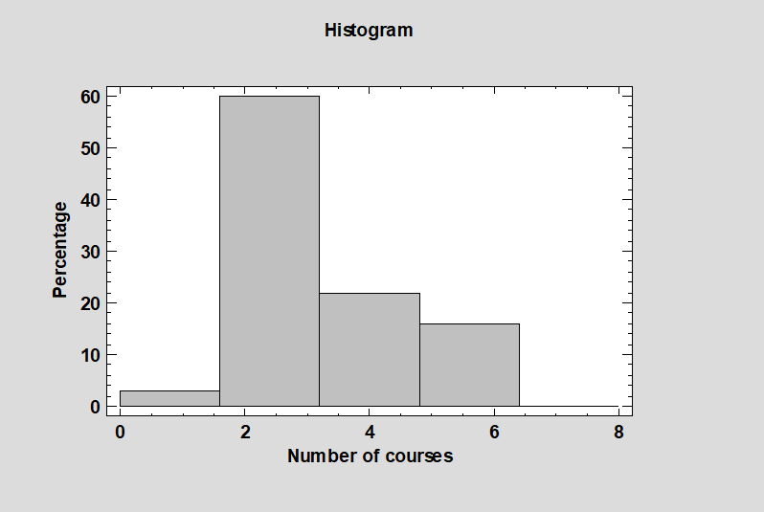
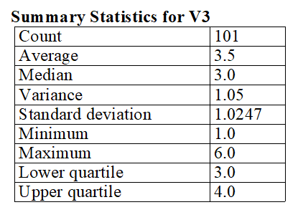
Data Variable: V3 (Number of courses)
V3 -
 | Lower | Upper |  |  | Relative | Cumulative | Cum. Rel.
Class | Limit | Limit | Midpoint | Frequency | Frequency | Frequency | Frequency
 | at or below | 0 |  | 0 | 0.0000 | 0 | 0.0000
1 | 0 | 1.6 | 0.8 | 3 | 0.0297 | 3 | 0.0297
2 | 1.6 | 3.2 | 2.4 | 60 | 0.5941 | 63 | 0.6238
3 | 3.2 | 4.8 | 4.0 | 22 | 0.2178 | 85 | 0.8416
4 | 4.8 | 6.4 | 5.6 | 16 | 0.1584 | 101 | 1.0000
5 | 6.4 | 8.0 | 7.2 | 0 | 0.0000 | 101 | 1.0000
 | above | 8 |  | 0 | 0.0000 | 101 | 1.0000
Interpretation:
The shape of the distribution (histogram) “number of courses” is skewed to the right. The median number of courses in the sample was 3, and sample mean was approximately 3.5 The IQR was 1 course. The standard deviation was 1.025 courses. The number of courses ranged from 1 to 6. There are no outliers.
Mean = 3.5 Standard deviation = 1.0247

Slide 10
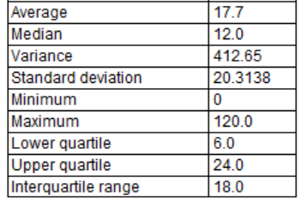
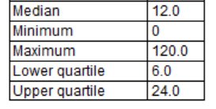
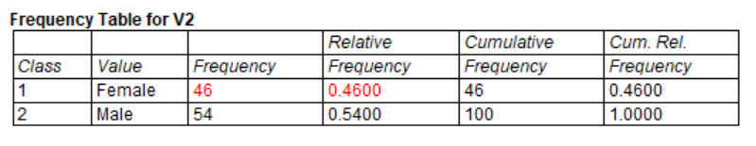
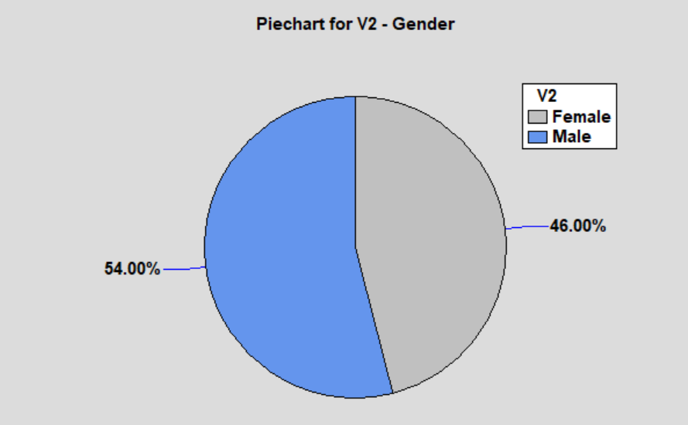
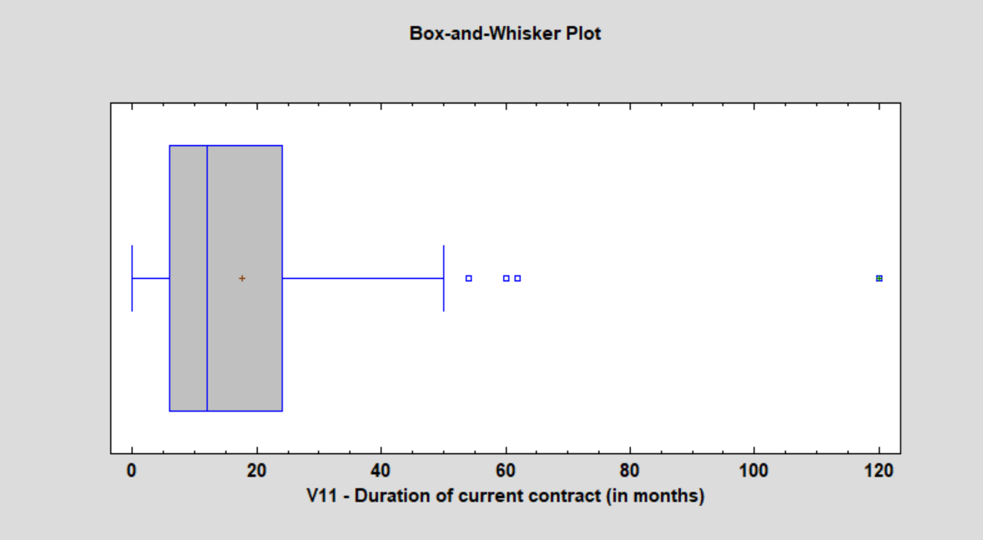
Data variable: V11 (Duration of current contract – in months)
101 values ranging from 0 to 120.0
Data variable: V2 (Gender)
Number of observations: 100
Number of unique values: 2
Summary Statistics for V11
Tukey’s 5 number summary
Interpretation:
From pie chart we can see that 54% of the students are male in our sample and rest 46% students are female. The ratio for male students in this study is more as compared to female students.
Interpretation:
The shape of the distribution appears to be skewed to the right. The median is 12 and sample mean is 17.7. The range is between 0 and 120. There are some outliers as well.

Slide 11
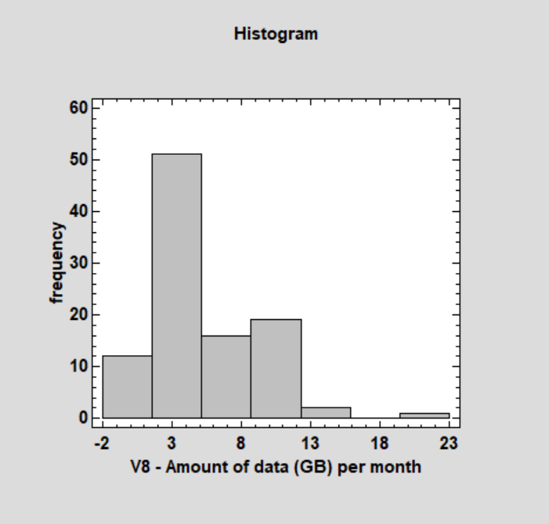
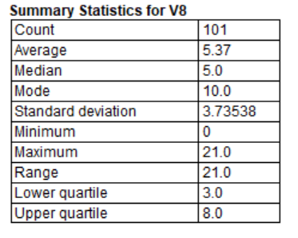
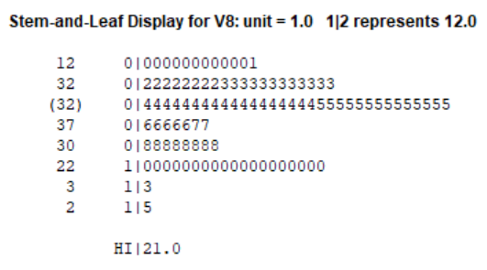
Percentage
Data Variable: V8 – Amount of data (GB) per month
\\\\\\
Frequency Tabulation for V8
 | Lower | Upper |  |  | Relative | Cumulative |  | Cum. Rel.
Class | Limit | Limit | Midpoint | Frequency | Frequency | Frequency | Class | Frequency
 | at or below | -1 |  | 0 | 0 | 0 |  | 0
1 | -1 | 2.16667 | 0.083333 | 20 | 0.198 | 20 | 1 | 0.198
2 | 2.16667 | 6.33333 | 4.25 | 49 | 0.4851 | 69 | 2 | 0.6832
3 | 6.33333 | 10.5 | 8.41667 | 29 | 0.2871 | 98 | 3 | 0.9703
4 | 10.5 | 14.6667 | 12.5833 | 1 | 0.0099 | 99 | 4 | 0.9802
5 | 14.6667 | 18.8333 | 16.75 | 1 | 0.0099 | 100 | 5 | 0.9901
6 | 18.8333 | 23 | 20.9167 | 1 | 0.0099 | 101 | 6 | 1
 | above | 23 |  | 0 | 0 | 101 |  | 1
Interpretation:
From the above histogram, we can see that it skewed to the right and have some outliers. The median for the distribution is 5 and the mean is 5.37. The range is between 0 and 21.

Slide 12
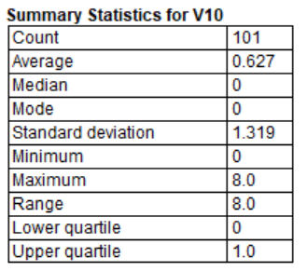
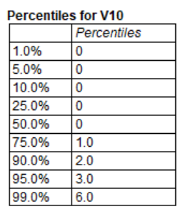
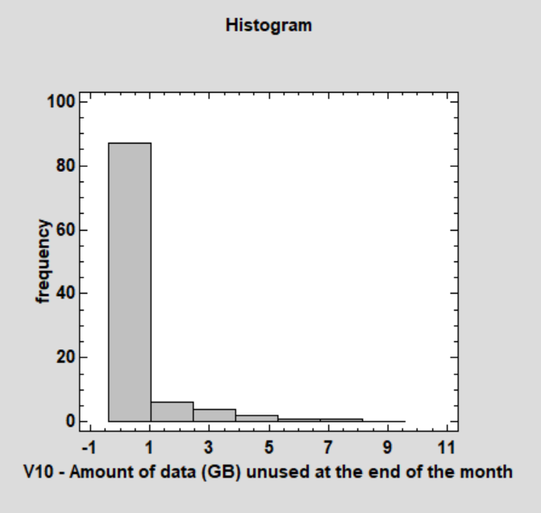
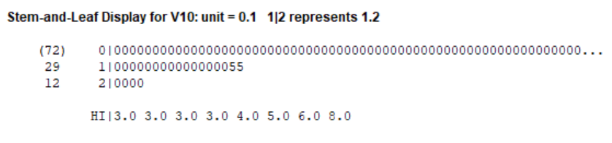
Percentage
Data Variable: V10 – Amount of data (GB) unused at the end of the month
Frequency Tabulation for V10
 | Lower | Upper |  |  | Relative | Cumulative |  | Cum. Rel.
Class | Limit | Limit | Midpoint | Frequency | Frequency | Frequency | Class | Frequency
 | at or below | -0.4 |  | 0 | 0 | 0 |  | 0
1 | -0.4 | 1.02857 | 0.314286 | 87 | 0.8614 | 87 | 1 | 0.8614
2 | 1.02857 | 2.45714 | 1.74286 | 6 | 0.0594 | 93 | 2 | 0.9208
3 | 2.45714 | 3.88571 | 3.17143 | 4 | 0.0396 | 97 | 3 | 0.9604
4 | 3.88571 | 5.31429 | 4.6 | 2 | 0.0198 | 99 | 4 | 0.9802
5 | 5.31429 | 6.74286 | 6.02857 | 1 | 0.0099 | 100 | 5 | 0.9901
6 | 6.74286 | 8.17143 | 7.45714 | 1 | 0.0099 | 101 | 6 | 1
7 | 8.17143 | 9.6 | 8.88571 | 0 | 0 | 101 | 7 | 1
 | above | 9.6 |  | 0 | 0 | 101 |  | 1
Interpretation:
The shape of the histogram is skewed to right. The median for the data variable is 0 and mean is 0.627. Standard deviation for V10 is 1.319. The range is between 0 and 8. There are no outliers.

Slide 13
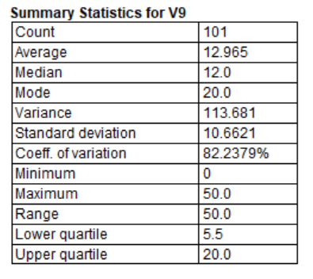
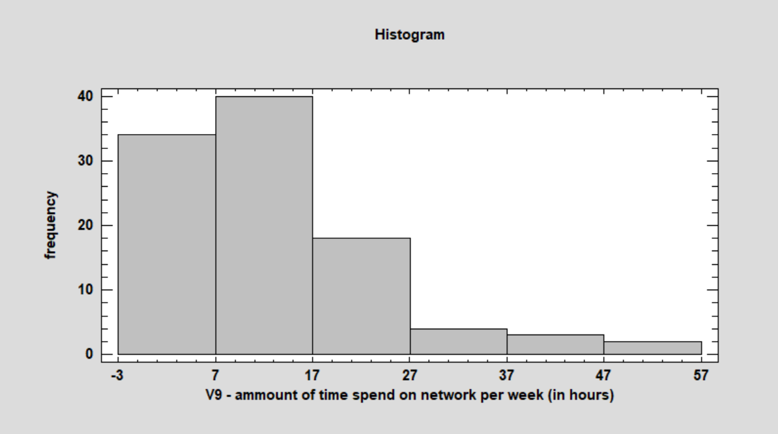
Data variable: V9 (Amount of time spend on network per week – in hours)
101 values ranging from 0 to 50.0
Percentage
Interpretation:
The shape of the diagram (Histogram) which we have drawn to analyze V9 is skewed to the right. The median time spend on network per week in the sample is 12, and sample mean is approximately 12.965 . The standard deviation is 10.662. The interquartile range is 14.5hours. There are no outliers.

Slide 14


Results
Bivariate Analysis

Slide 15
The objective of this exercise is to analyze bivariate quantitative data.
Using “Monthly bill” as dependent variable, we constructed scatter diagram for the independent variable “Amount of data”.
The Scatter diagram for “Monthly bill” and “Amount of data” exhibits the following features
Direction: Positive
Form: Linear
Strength: Moderately week
Outliers: None
Simple Regression - V6 (monthly bill in dollars) vs. V8 Amount of data GB
Dependent variable: V6
Independent variable: V8
Linear model: Y = a + b*X
Coefficients
Analysis of Variance
Correlation Coefficient = 0.592669
 | Least Squares | Standard | T
Parameter | Estimate | Error | Statistic | P-Value
Intercept | 44.8068 | 4.03075 | 11.1162 | 0.0000
Slope | 4.51866 | 0.617187 | 7.32138 | 0.0000
Source | Sum of Squares | Df | Mean Square | F-Ratio | P-Value
Model | 28489.9 | 1 | 28489.9 | 53.60 | 0.0000
Residual | 52618.6 | 99 | 531.501
Total (Corr.) | 81108.5 | 100

Slide 16
Now, we would like to demonstrate if there is statistically significant linear relationship between “Monthly Bill” and “Amount of data” in the population of all Langara students by carrying out the four steps of hypothesis testing to assess the statistical significance of “r”.
Step 1.
H0: rho = 0
There is no linear relationship between “Monthly Bill” and “Amount of data” in the population of all Langara students.
H1: rho is not =0
There is a linear relationship between the “Monthly Bill’ and “Amount of data” in the population of all Langara students.
Step 2:
Correlation coefficient = 0.592669
Calculate Test Statistic
TS= r= 0.593
Step 3:
Since the Test statistic = 0.593 is greater than the positive decision point= 0.197 (for n= 100), we have enough evidence to reject the Null hypothesis.
Step 4: We conclude that there is statistically significant (positive) linear relationship between “Monthly Bill” and “Amount of data” in the population of all Langara students. The strength is weak
Estimated regression equation:
yhat= b0+b1x = 44.8068+4.51866x
Interpretation:
For each additional GB of data, there is an increase in the amount spent of 4.52 dollars.

Slide 17
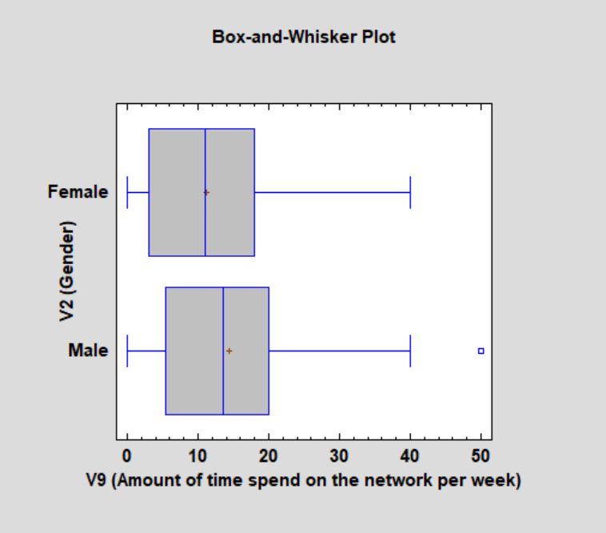
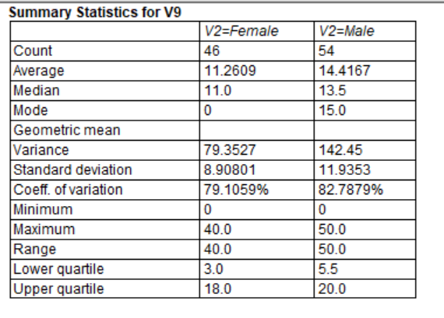
Multiple Sample Comparison
Dependent variable: V9 (Amount of time spend on the network per week)
Factor: V2 (Gender)
Number of observations: 100
Number of levels: 2
Interpretation:
The shape of both the diagrams (Box and whisker for Female and Box and whisker for male) appears to be almost same. The minimum for both is 0 but there is a difference of 10hours in the maximum of both the diagrams. It can be seen that median for the male (13.5) is higher than female(11) which depicts that the male spend more time on network as compared to female every week. The average for female is 11.26 and for male is 14.41. The interquartile range for female is 15 and for male is 14.5. There are some outliers as well.

Slide 18
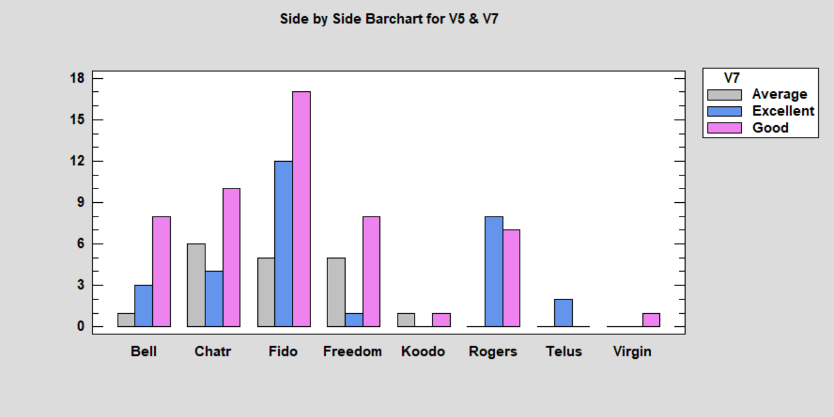
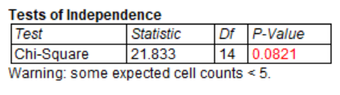
Crosstabulation - V5 by V7
Row variable: V5 (Mobile network used)
Column variable: V7 (Rating of range of mobile network)
Number of observations: 100
Number of rows: 8
Number of columns: 3
Frequency
Frequency Table for V5 by V7
 | Average | Excellent | Good | Row Total
Bell | 1 | 3 | 8 | 12
 | 1.00% | 3.00% | 8.00% | 12.00%
 | 2.16 | 3.60 | 6.24
 | 0.62 | 0.10 | 0.50
Chatr | 6 | 4 | 10 | 20
 | 6.00% | 4.00% | 10.00% | 20.00%
 | 3.60 | 6.00 | 10.40
 | 1.60 | 0.67 | 0.02
Fido | 5 | 12 | 17 | 34
 | 5.00% | 12.00% | 17.00% | 34.00%
 | 6.12 | 10.20 | 17.68
 | 0.20 | 0.32 | 0.03
Freedom | 5 | 1 | 8 | 14
 | 5.00% | 1.00% | 8.00% | 14.00%
 | 2.52 | 4.20 | 7.28
 | 2.44 | 2.44 | 0.07
Other(Koodo) | 1 | 0 | 1 | 2
 | 1.00% | 0.00% | 1.00% | 2.00%
 | 0.36 | 0.60 | 1.04
 | 1.14 | 0.60 | 0.00
Other(Rogers) | 0 | 8 | 7 | 15
 | 0.00% | 8.00% | 7.00% | 15.00%
 | 2.70 | 4.50 | 7.80
 | 2.70 | 2.72 | 0.08
Other(Telus) | 0 | 2 | 0 | 2
 | 0.00% | 2.00% | 0.00% | 2.00%
 | 0.36 | 0.60 | 1.04
 | 0.36 | 3.27 | 1.04
Other(Virgin) | 0 | 0 | 1 | 1
 | 0.00% | 0.00% | 1.00% | 1.00%
 | 0.18 | 0.30 | 0.52
 | 0.18 | 0.30 | 0.44
Column Total | 18 | 30 | 52 | 100
 | 18.00% | 30.00% | 52.00% | 100.00%
V5 – Mobile network used
Cell contents:
Observed frequency
Percentage of table
Expected frequency
Contribution to chi-square
Interpretation:
From side by side bar chart we can see that for majority of students that use different mobile network have rated most of the network as good and few as excellent, Students have also given a rating of average for some networks like Chatr and Freedom. Since more than 20% of cell count is less than 5 so, we are unable to use the chi-square statistics.

Slide 19

Summary
In our study, we have more male members in our data set and most of the students have 3-4 courses in their spring semester 2018.
Students spend 5-20 hours every week on the network and males tend to spend more time on network as compared to female
The monthly bill that students usually pay range from $50 to $85 and they are satisfied with their monthly bill. On the other hand for every additional GB of data they need to pay $4.52.
Students get a monthly data of 3-8 GB and they almost use all the available data and the amount of data left behind unused at the end of month is very low.

Slide 20

Conclusion
From our study, we can conclude that Chatr, Fido and Rogers are the most popular mobile networks among the Langara students. But the among these three most popular mobile networks, Fido is the one which is used more by the students (34% students used Fido).

Slide 21

Thank You
Group 7
Mehak Chatrath
Sinisa Nezic
Saurav

